Slide 1


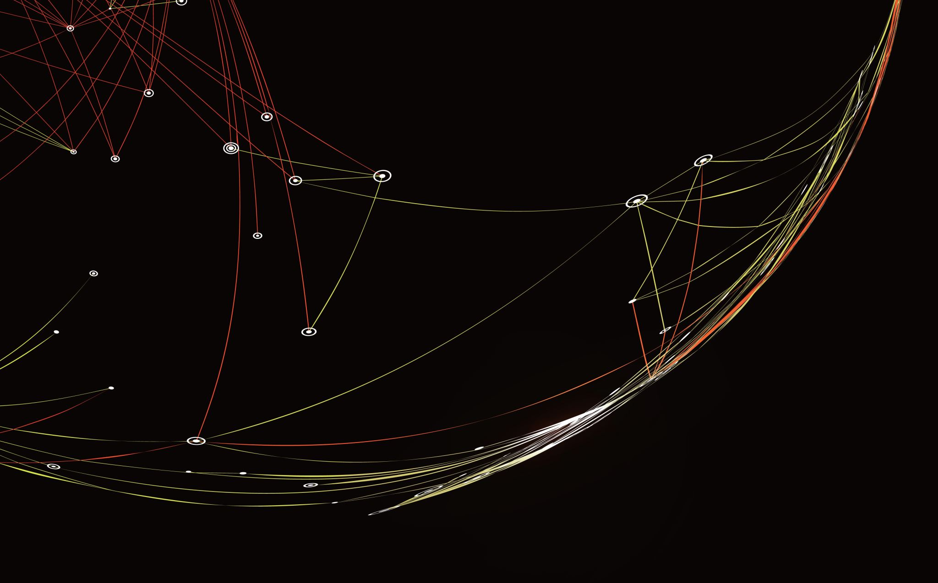
Sign Me Up Training
Fall 2025

Slide 2
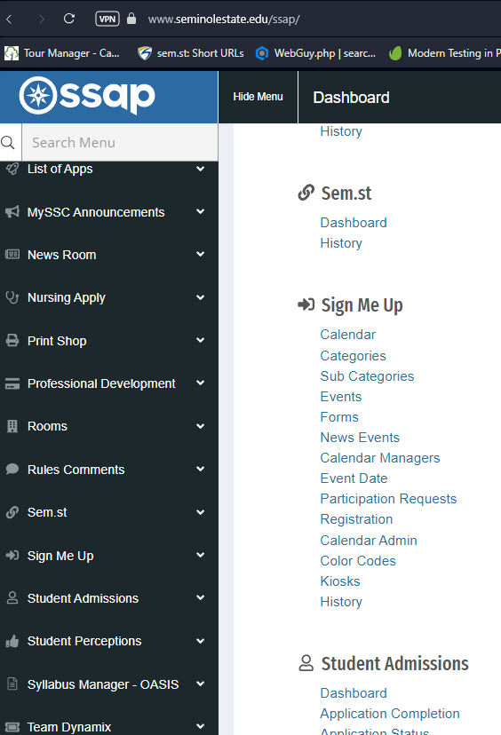
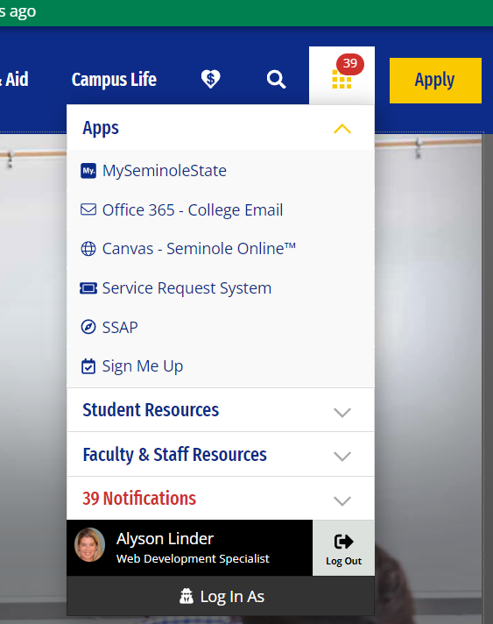
What is Sign Me Up?
It’s the College’s official calendaring system, located in SSAP.
How do I access Sign Me Up?

Slide 3
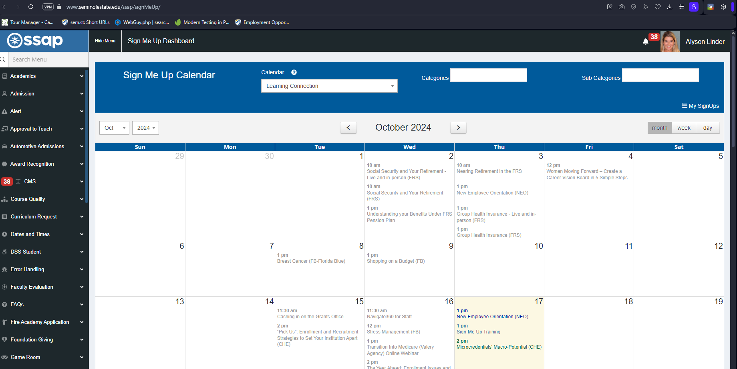
Sign Me Up Calendar Dashboard

Slide 4
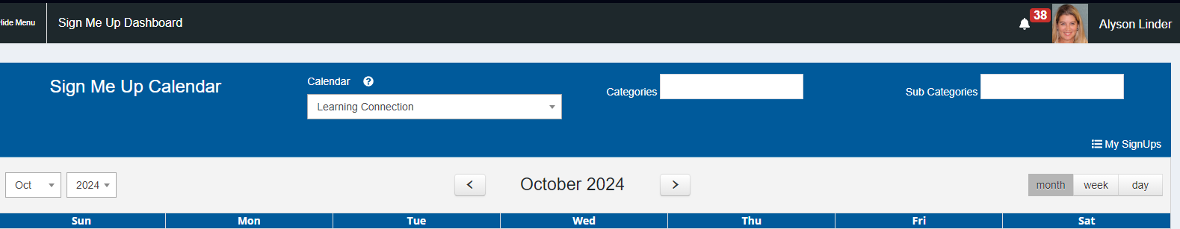
Dashboard Sections
Calendar field
My SignUps
Categories field Sub Categories field
Calendar view – select by month, week, day

Slide 5

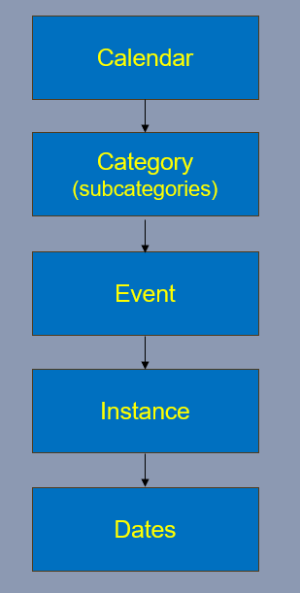
Sign Me Up Structure
The Big Picture

Slide 6

SMU Structure: Calendar → Category → Event → Instance → Dates
Event has 3 parts:
EVENT
1 - Event Details
S
M
U
2 - Event Instance
3 - Event Dates

Slide 7
Example in Sign Me Up Application
“Automotive” Calendar →
“Automotive Tours” Category →
“Automotive Program Tour” Event →
“Sanford/Lake Mary” (Campus) AT0102 Automotive Showroom Lobby (Location) Instance →
“Thurs. 10.16.25; Thurs. 11.13.25; Thurs. 12.11.25” Dates
Multiple
Instances or Dates
can be associated with
an Event

Slide 8
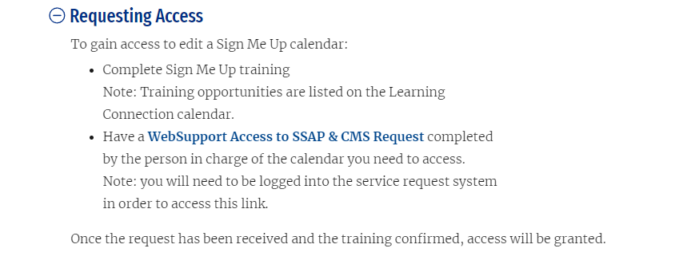
Sign Me Up Documentation
https://www.seminolestate.edu/docs-ssap/sign-me-up
How Do I get Access?

Slide 9
Let’s view the Sign Me Up application on the website
Questions?
Alyson Linder lindera@seminolestate.edu
or on Microsoft Teams

